Slide 1

CSE3001 - SOFTWARE ENGINEERING
BY
SANJIL K C (20BCE1855)
SAURAV PANDEY (20BCE1749)
DEVARINTI DHAPATLA
PUNEETH REDDY (20BCE1852)
E
COMMERCE
REVIEW
SYSTEM
REVIEW 3

Slide 2

Video Link
https://drive.google.com/drive/folders/1QGLzTCe2uiQuyrtKIkcUHvXtNTlIQmqo?usp=sharing

Slide 3
ABSTRACT
As most of the people require review about a product before spending their money on the product. So, people come across various reviews in the website but these reviews are genuine or fake is not identified by the user. In some review websites some good reviews are added by the product company people itself in order to make product famous this people belong to Social Media Optimization team. They give good reviews for many different products manufactured by their own firm. User will not be able to find out whether the review is genuine or fake. To find out fake review in the website this “Fake Product Review Monitoring and Removal for Genuine Online Product Reviews Using Opinion Mining” system is introduced. This system will find out fake reviews made by the social media optimization team by identifying the IP address. User will login to the system using his user id and password and will view various products and will give review about the product. To find out the review is fake or genuine, system will find out the IP address of the user if the system observes fake review send by the same IP Address many a times it will inform the admin to remove that review from the system. This system uses data mining methodology. This system helps the user to find out correct review of the product.

Slide 4
The Software Requirements Specification is designed to document and describe the agreement between the customer and the developer regarding the specification of the software product requested. Its primary purpose is to provide a clear and descriptive “statement of user requirements” that can be used as a reference in further development of the software system. This document is broken into a number of sections used to logically separate the software requirements into easily referenced parts. This Software Requirements Specification aims to describe the Functionality, External Interfaces, Attributes and Design Constraints imposed on Implementation of the software system described throughout the rest of the document. Throughout the description of the software system, the language and terminology used should be unambiguous and consistent throughout the document.
INTRODUCTION

Slide 5
OBJECTIVE
User once access the system; user can view product and can post review about the product.
Admin will delete the review which is fake
System will track the IP address of the user.
Admin will add products to the system..
If the system observes fake review coming from same IP address many a times this IP address will be tracked by the system and will inform the admin to remove this review from the system.
A database which will contain the details of the users and the products to be registered

Slide 6
PROJECT SCOPE
The E-Commerce Site Utilizing an Honest Review System will allow any user to create an account to become a customer. The customer, through the process of account creation, will have the option to become a member of the site. The system will allow customers to browse, search, select, and add things to a shopping cart. The system also allows a manager to manage the inventory with full create, retrieve, update and delete functionality with regards to reviews given in the system. It will also allow, on an inventory wide basis, customers and managers to interact.

Slide 7
This system provides an easy solution for customers to buy the product without going to the shop and also to shop owner to sale the product. This proposed system can be used by any naïve users and it does not require any educational level, experience or technical expertise in computer field but it will be of good use if user has the good knowledge of how to operate a computer.
OVERVIEW

Slide 8
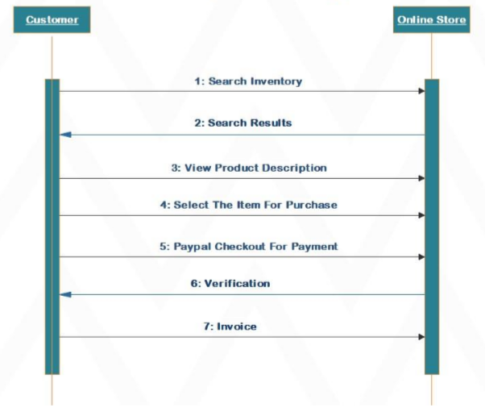
SEQUENCE DIAGRAM
SEQUENCE DIAGRAM

Slide 9
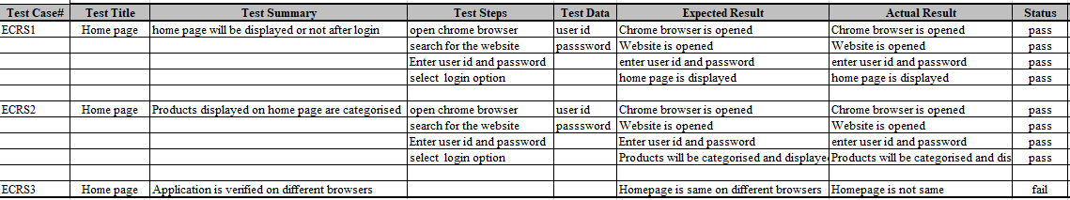
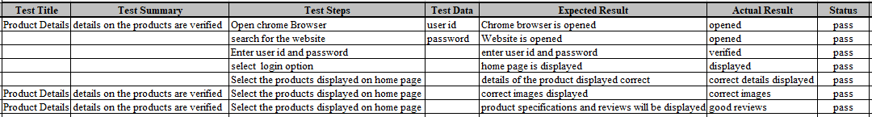
TEST CASE 1
HOME PAGE
TEST CASE 2
PRODUCT DETAILS

Slide 10
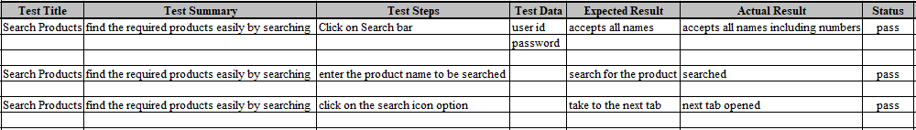
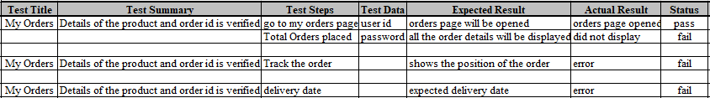
TEST CASE 3
SEARCH PRODUCT
TEST CASE 4
MY ORDERS

Slide 11
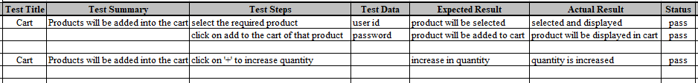
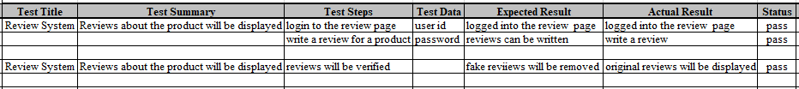
TEST CASE 5
CART
TEST CASE 6
REVIEW SYSTEM

Slide 12
Conclusion
There have been made several attempts for spam review detection till today. In this paper, we propose a general framework to detect spam reviews. Sentiment analysis or opinion mining is a field of study that analyses people’s sentiments, feelings, or emotions towards certain entities. This paper tackles a fundamental problem of sentiment analysis, sentiment polarity categorization. Now a day’s technology is growing day by day and there are so many websites and application available in the online market by which they sell their product. Every product contains millions of reviews and on basis of these reviews' user buy the product most of the time. There are some organizations which post fake reviews on genuine product and user gets stuck.
Our software will help the user to pay for the right product. Our software will do analysis and then if any fake review is found from any IP address consistently then admin user can block that IP address. It also sends mail to user regarding blocked IP address. In this way it monitors the fake review made on any product. And user can be sure about the products availability on that application and reviews too

Slide 13

THANK YOU

